Slide 1
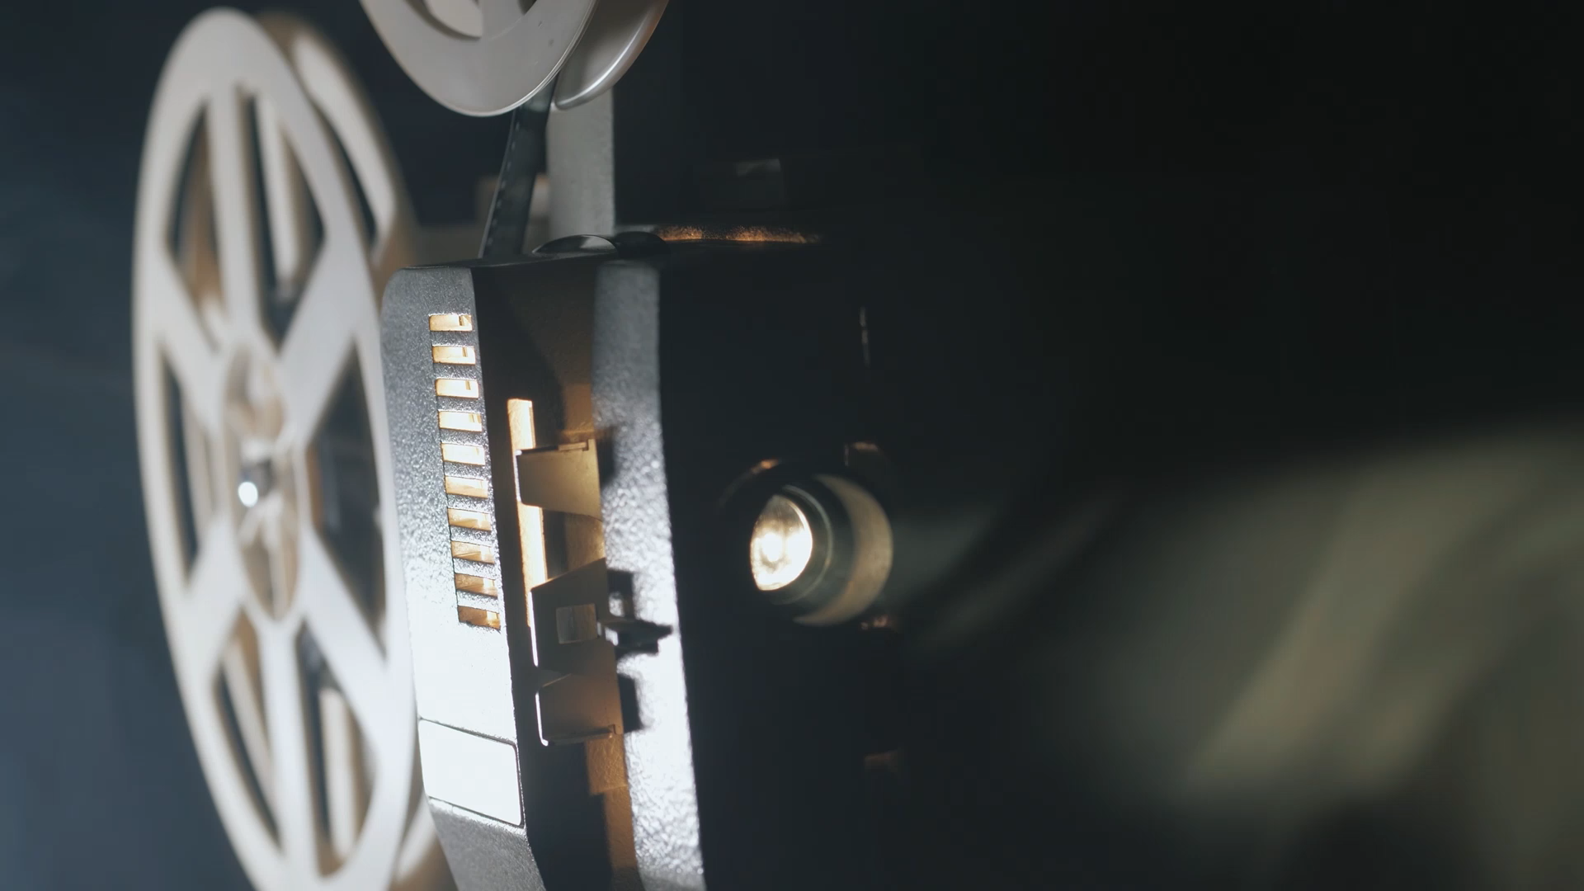
Movie Recommendation System leveraging Artificial Intelligence Techniques
- The Movie Recommendation System Using AI is an intelligent, web-based application that leverages machine learning techniques to suggest personalized movie recommendations to users. Developed using Flask for web development and Python with machine learning algorithms like TF-IDF Vectorization and cosine similarity, the system analyzes user preferences and computes similarity between user input (genres or queries) and movie data.
- The system uses a dataset of movie features such as genres, ratings, and descriptions to compute movie similarity. When a user interacts with the intuitive web interface by selecting a genre or submitting a query, the system identifies the most relevant movies from the database and returns the top recommendations.
The core features of this project include:
Machine Learning Integration: Using TF-IDF Vectorization to convert movie descriptions into numerical data.
Cosine Similarity Computation: Calculations that determine how similar a user’s input is to the movies in the dataset.
User-friendly UI: Developed with HTML and Bootstrap, offering a simple and intuitive user experience.
Flask Back-End: Efficient communication between user input, machine learning logic, and the database.
This system demonstrates the integration of machine learning models with web frameworks to create intelligent applications. It is a practical project that highlights the application of AI concepts in a real-world, interactive environment.

